Slide 1
19
Introduction to Classes and Objects

Slide 2
OBJECTIVES
In this chapter you will learn:
What classes, objects, member functions and data members are.
How to define a class and use it to create an object.
How to define member functions in a class to implement the class's behaviors.
How to declare data members in a class to implement the class's attributes.
How to call a member function of an object to make that member function perform its task.
The differences between data members of a class and local variables of a function.
How to use a constructor to ensure that an object's data is initialized when the object is created.
How to engineer a class to separate its interface from its implementation and encourage reuse.

Slide 3
19.1 Introduction
19.2 Classes, Objects, Member Functions and Data Members
19.3 Overview of the Chapter Examples
19.4 Defining a Class with a Member Function
19.5 Defining a Member Function with a Parameter
19.6 Data Members, set Functions and get Functions
19.7 Initializing Objects with Constructors
19.8 Placing a Class in a Separate File for Reusability
19.9 Separating Interface from Implementation
19.10 Validating Data with set Functions

Slide 4
19.1 Introduction
Typically
  Programs will consist of
    Function main and
    One or more classes
      Each containing data members and member functions

Slide 5
19.2 Classes, Objects, Member Functions and Data Members
Review of classes: Car example
  Functions describe the mechanisms that perform a tasks, such as acceleration
    Hides complex tasks from user, just as a driver can use the pedal to accelerate without needing to know how the acceleration is performed
  Classes must be defined before they can be used, car must be built before it can be driven
  Many car objects created from same class, many cars built from same engineering drawing

Slide 6
19.2 Classes, Objects, Member Functions and Data Members (Cont.)
Review of classes: Car example (Cont.)
  Member-function calls send messages to an object to perform tasks, just like pressing the gas pedal sends a message to the car to accelerate
  Objects and cars both have attributes, like color and miles driven

Slide 7
19.3 Overview of the Chapter Examples
Seven simple examples
  Examples used to build a GradeBook class
Topics covered:
  Member functions
  Data members
  Clients of a class
    Other classes or functions that call the member functions of this class’s objects
  Separating interface from implementation
  Data validation
    Ensures that data in an object is in a particular format or range

Slide 8
19.4 Defining a Class With a Member Function
Class definition
  Tells compiler what member functions and data members belong to the class
  Keyword class followed by the class’s name
  Class body is enclosed in braces ({})
    Specifies data members and member functions
    Access-specifier public:
      Indicates that a member function or data member is accessible to other functions and member functions of other classes

Slide 9
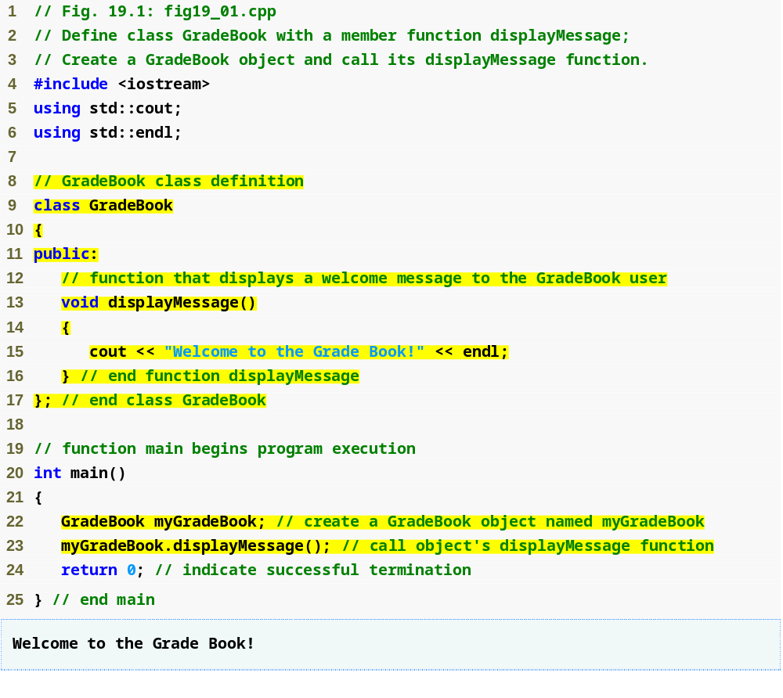
Outline
fig19_01.cpp
(1 of 1)
Beginning of class definition for class GradeBook
Beginning of class body
Access specifier public; makes members available to the public
Member function displayMessge returns nothing
End of class body
Use dot operator to call GradeBook’s member function

Slide 10
19.4 Defining a Class With a Member Function (Cont.)
Member function definition
  Return type of a function
    Indicates the type of value returned by the function when it completes its task
    void indicates that the function does not return any value
  Function names must be a valid identifier
  Parentheses after function name indicate that it is a function
  Function body contains statements that perform the function’s task
    Delimited by braces ({})

Slide 11
Common Programming Errors
Forgetting the semicolon at the end of a class definition is a syntax error.
Returning a value from a function whose return type has been declared void is a compilation error.
Defining a function inside another function is a syntax error.

Slide 12
19.4 Defining a Class With a Member Function (Cont.)
Using a class
  A class is a user-defined type (or programmer-defined type)
    Can be used to create objects
      Variables of the class type
    C++ is an extensible language
  Dot operator (.)
    Used to access an object’s data members and member functions
    Example
      myGradeBook.displayMessage()
        Call member function displayMessage of GradeBook object myGradeBook

Slide 13
19.5 Defining a Member Function with a Parameter
Function parameter(s)
  Information needed by a function to perform its task
Function argument(s)
  Values supplied by a function call for each of the function’s parameters
    Argument values are copied into function parameters

Slide 14
19.5 Defining a Member Function with a Parameter (Cont.)
A string
  Represents a string of characters
  An object of C++ Standard Library class std::string
    Defined in header file <string>
Library function getline
  Used to retrieve input until newline is encountered
  Example
    getline( cin, nameOfCourse );
      Inputs a line from standard input into string object nameOfCourse

Slide 15
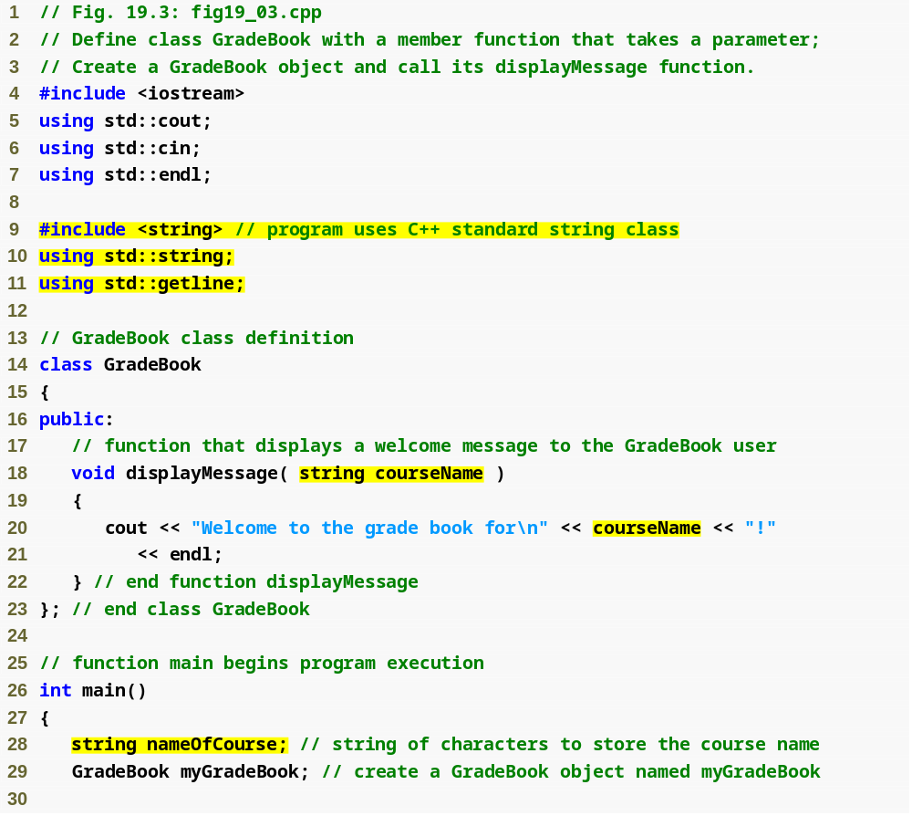
Outline
Include string class definition
fig19_03.cpp
(1 of 2)
Member function parameter
Use the function parameter as a variable

Slide 16
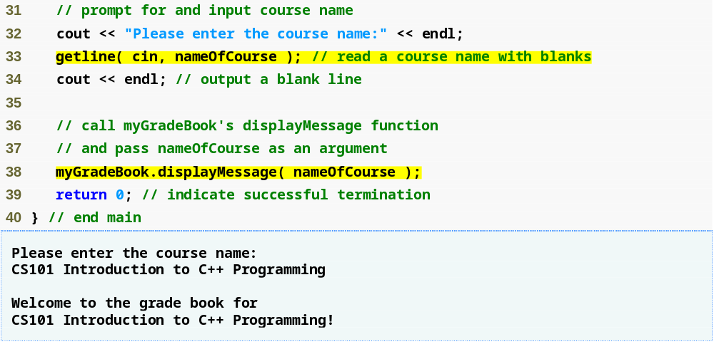
Outline
fig19_03.cpp
(2 of 2)
Passing an argument to the member function

Slide 17
19.5 Defining a Member Function with a Parameter (Cont.)
Parameter Lists
  Additional information needed by a function
  Located in parentheses following the function name
  Function may have any number of parameters
    Parameters separated by commas
  Number, order and types of arguments in a function call must match the number, order and types of parameters in the called function’s parameter list
  Modeled in UML
    Parameter name, followed by a colon and the parameter type in the member function’s parentheses

Slide 18
19.6 Data Members, set Functions and get Functions
Local variables
  Variables declared in a function definition’s body
    Cannot be used outside of that function body
  When a function terminates
    The values of its local variables are lost
Attributes
  Exist throughout the life of the object
  Represented as data members
    Variables in a class definition
  Each object of class maintains its own copy of attributes

Slide 19
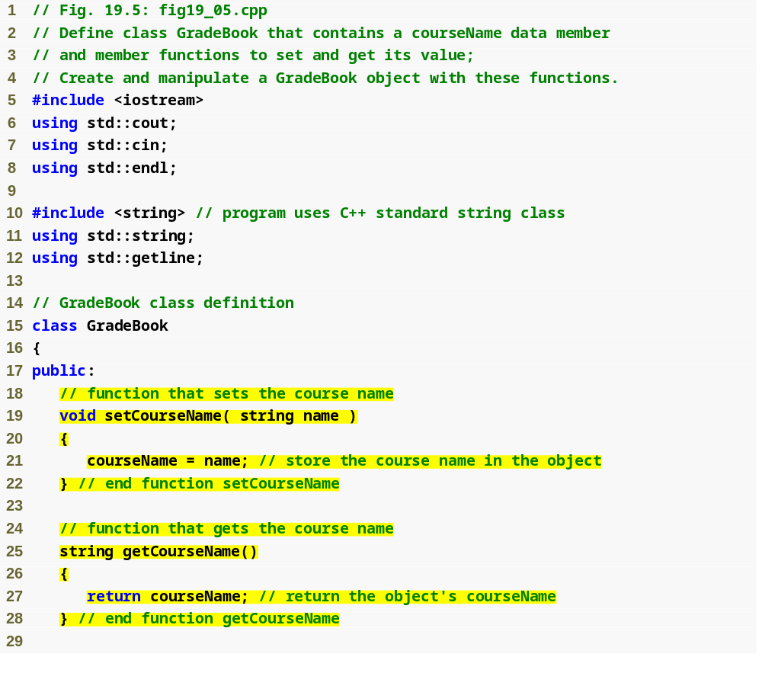
Outline
fig19_05.cpp
(1 of 3)
set function modifies private data
get function accesses private data

Slide 20
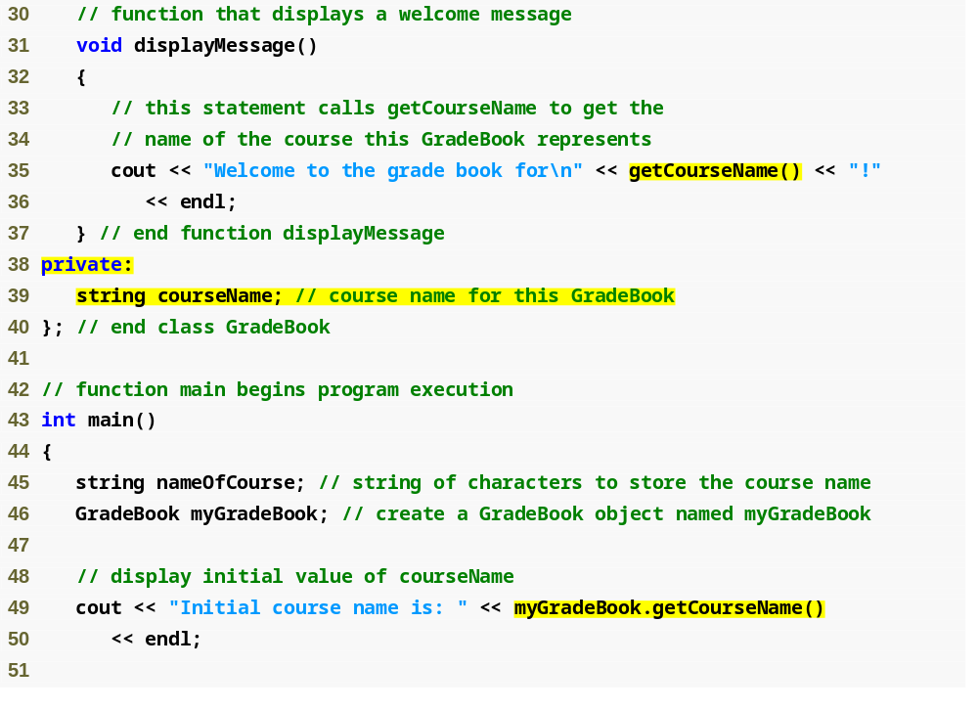
Outline
fig19_05.cpp
(2 of 3)
Use set and get functions, even within the class
private members accessible only to member functions of the class
Accessing private data outside class definition

Slide 21
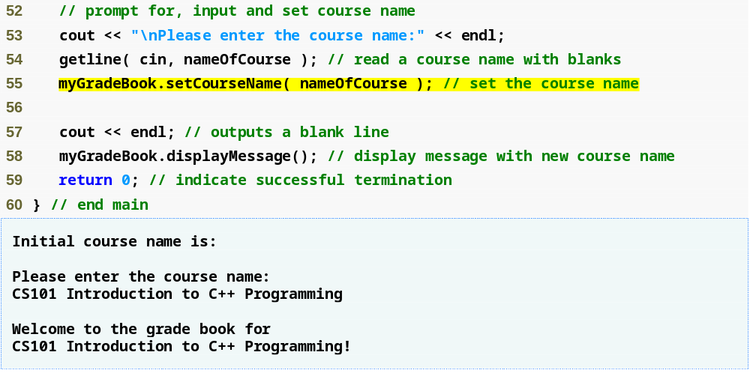
Outline
fig19_05.cpp
(3 of 3)
Modifying private data outside class definition

Slide 22
19.6 Data Members, set Functions and get Functions (Cont.)
Access-specifier private
  Makes a data member or member function accessible only to member functions of the class
  private is the default access for class members
  Data hiding
Returning a value from a function
  A function that specifies a return type other than void
    Returns a value to its calling function

Slide 23
Software Engineering Observation 19.1
As a rule of thumb, data members should be declared private and member functions should be declared public. (We will see that it is appropriate to declare certain member functions private, if they are to be accessed only by other member functions of the class.)

Slide 24
19.6 Data Members, set Functions and get Functions (Cont.)
Software engineering with set and get functions
  public member functions that allow clients of a class to set or get the values of private data members
  set functions sometimes called mutators and get functions sometimes called accessors
  Allows the creator of the class to control how clients access private data
  Should also be used by other member functions of the same class

Slide 25
19.7 Initializing Objects with Constructors
Constructors
  Functions used to initialize an object’s data when it is created
    Call made implicitly when object is created
    Must be defined with the same name as the class
    Cannot return values
      Not even void
  Default constructor has no parameters
    The compiler will provide one when a class does not explicitly include a constructor
      Compiler’s default constructor only calls constructors of data members that are objects of classes

Slide 26
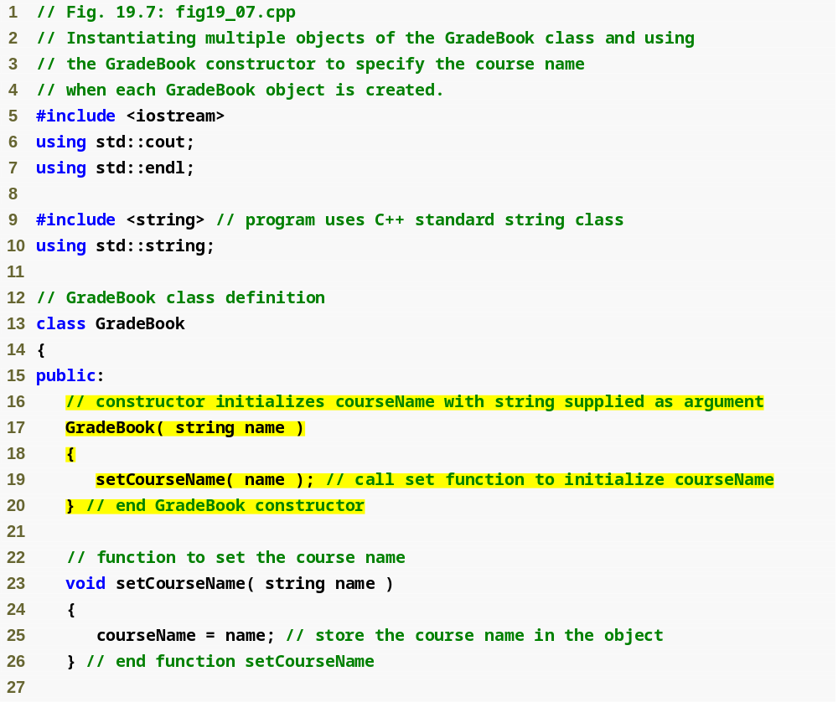
Outline
fig19_07.cpp
(1 of 3)
Constructor has same name as class and no return type
Initialize data member

Slide 27
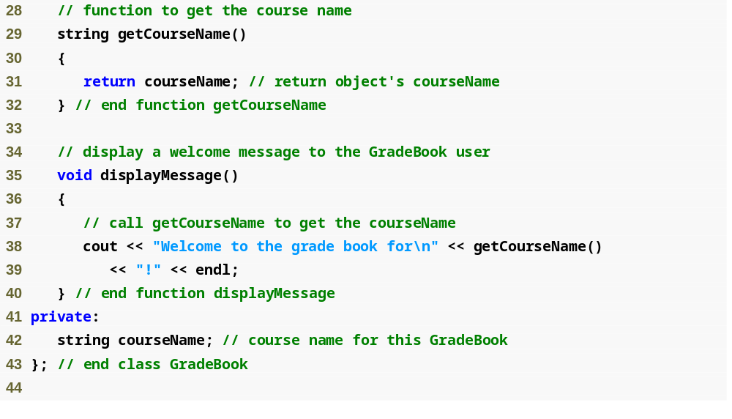
Outline
fig19_07.cpp
(2 of 3)

Slide 28
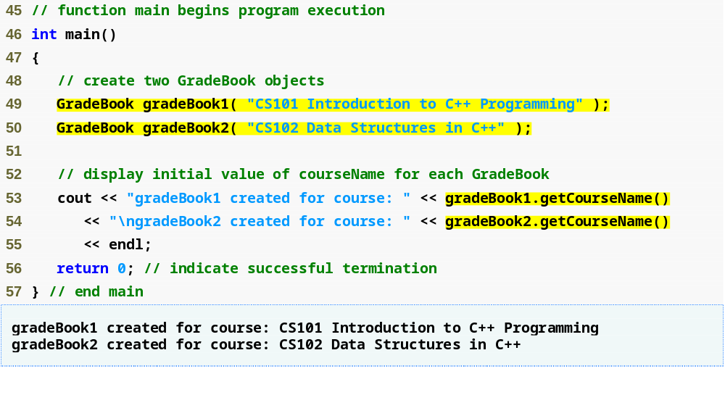
Outline
fig19_07.cpp
(3 of 3)
Creating objects implicitly calls the constructor

Slide 29
Error-Prevention Tip 19.2
Unless no initialization of your class’s data members is necessary (almost never), provide a constructor to ensure that your class’s data members are initialized with meaningful values when each new object of your class is created.

Slide 30
Software Engineering Observation 19.5
Data members can be initialized in a constructor of the class or their values may be set later after the object is created. However, it is a good software engineering practice to ensure that an object is fully initialized before the client code invokes the object’s member functions. In general, you should not rely on the client code to ensure that an object gets initialized properly.

Slide 31
19.8 Placing a Class in a Separate File for Reusability
.cpp file is known as a source-code file
Header files
  Separate files in which class definitions are placed
    Allow compiler to recognize the classes when used elsewhere
  Generally have .h filename extensions
Driver files
  Program used to test software (such as classes)
  Contains a main function so it can be executed

Slide 32
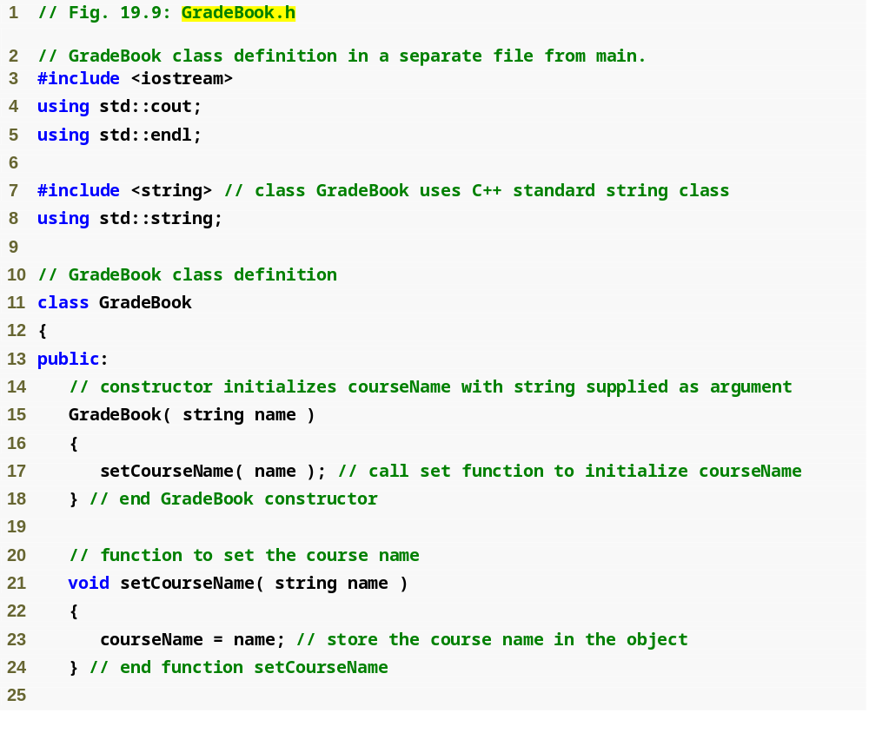
Outline
Class definition is in a header file
fig19_09.cpp
(1 of 2)

Slide 33
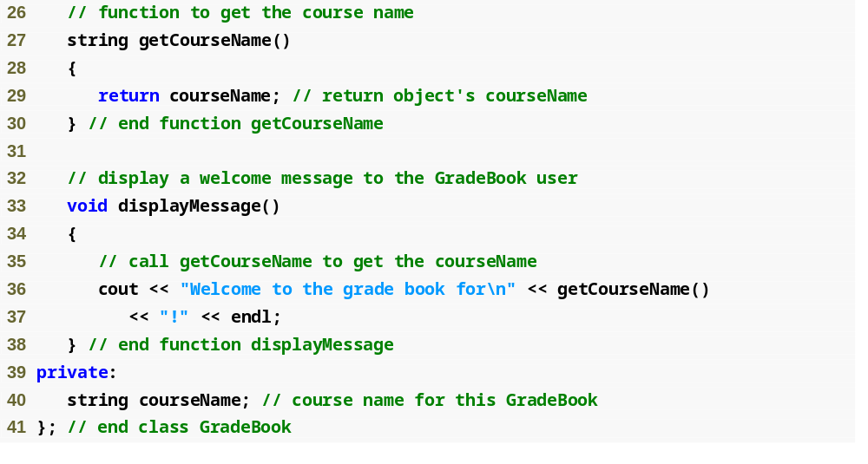
Outline
fig19_09.cpp
(2 of 2)

Slide 34
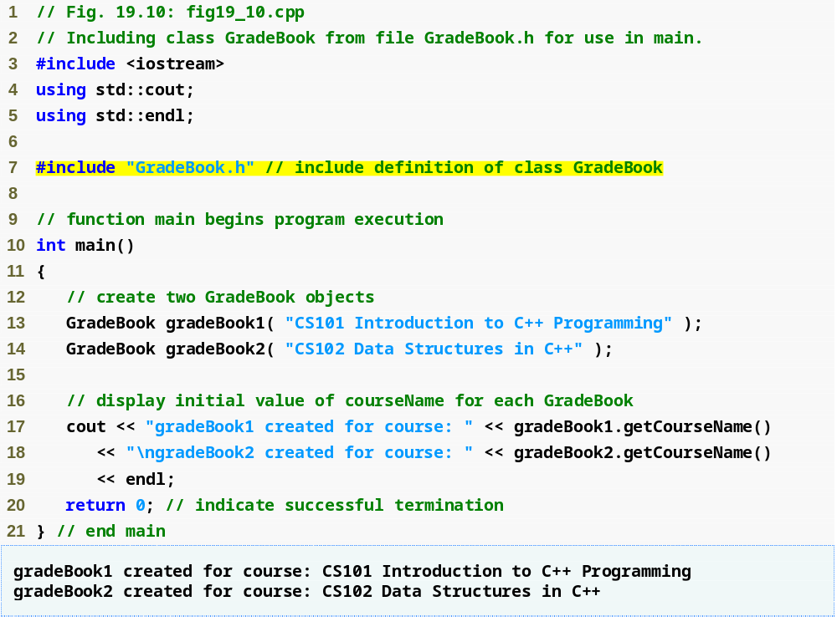
Outline
fig19_10.cpp
(1 of 1)
Including the header file causes the class definition to be copied into the file

Slide 35
19.8 Placing a Class in a Separate File for Reusability (Cont.)
#include preprocessor directive
  Used to include header files
    Instructs C++ preprocessor to replace directive with a copy of the contents of the specified file
  Quotes indicate user-defined header files
    Preprocessor first looks in current directory
      If the file is not found, looks in C++ Standard Library directory
  Angle brackets indicate C++ Standard Library
    Preprocessor looks only in C++ Standard Library directory

Slide 36
19.8 Placing a Class in a Separate File for Reusability (Cont.)
Creating objects
  Compiler must know size of object
    C++ objects typically contain only data members
    Compiler creates one copy of class’s member functions
      This copy is shared among all the class’s objects

Slide 37
19.9 Separating Interface from Implementation
Interface
  Describes what services a class’s clients can use and how to request those services
    But does not reveal how the class carries out the services
    A class definition that lists only member function names, return types and parameter types
      Function prototypes
  A class’s interface consists of the class’s public member functions (services)
Separating interface from implementation
  Client code should not break if implementation changes, as long as interface stays the same

Slide 38
19.9 Separating Interface from Implementation (Cont.)
Separating interface from implementation (Cont.)
  Define member functions outside the class definition, in a separate source-code file
    In source-code file for a class
      Use binary scope resolution operator (::) to tie each member function to the class definition
    Implementation details are hidden
      Client code does not need to know the implementation
  In header file for a class
    Function prototypes describe the class’s public interface

Slide 39
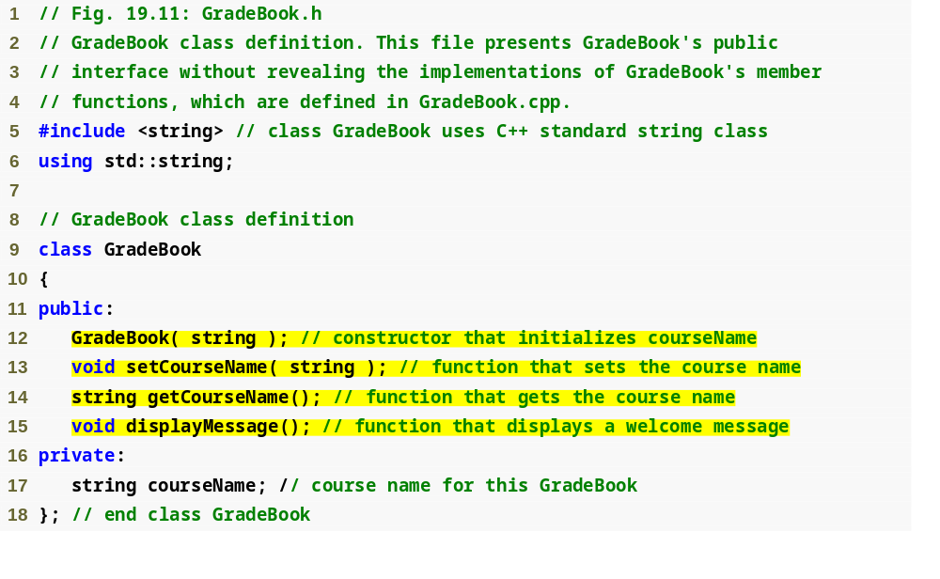
Outline
fig19_11.cpp
(1 of 1)
Interface contains data members and member function prototypes

Slide 40
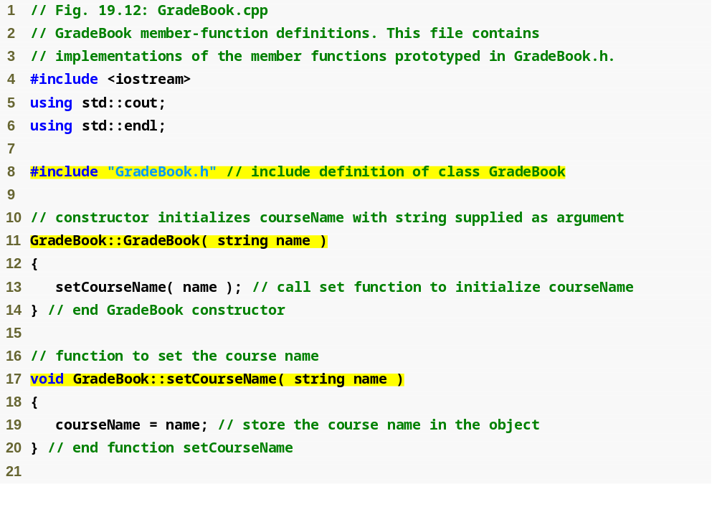
Outline
GradeBook implementation is placed in a separate source-code file
fig19_12.cpp
(1 of 2)
Include the header file to access the class name GradeBook
Binary scope resolution operator ties a function to its class

Slide 41
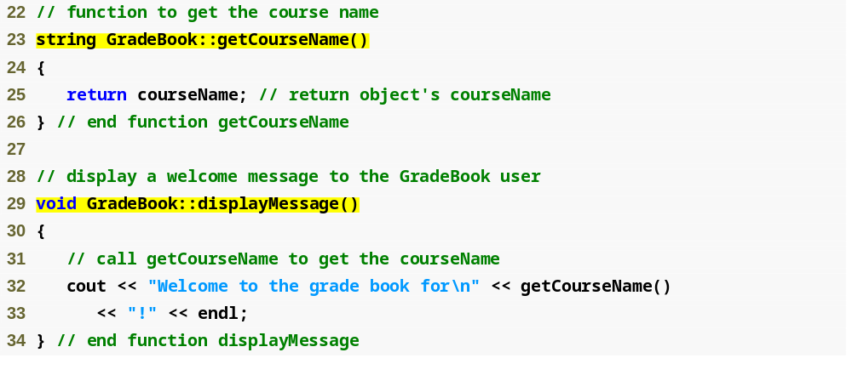
Outline
fig19_12.cpp
(2 of 2)

Slide 42
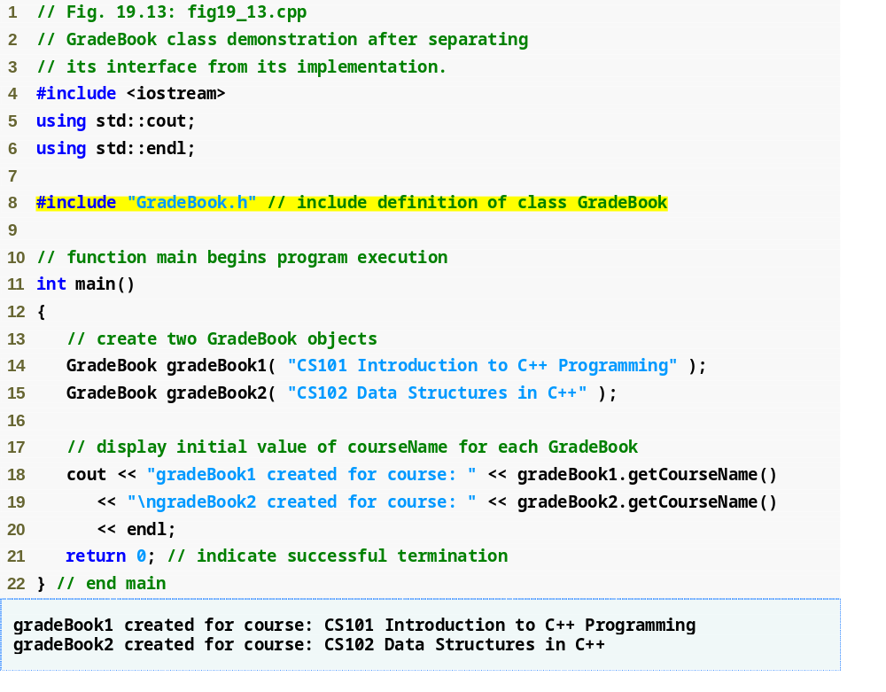
Outline
fig19_13.cpp
(1 of 1)

Slide 43
19.9 Separating Interface from Implementation (Cont.)
The Compilation and Linking Process
  Source-code file is compiled to create the class’s object code (source-code file must #include header file)
    Class implementation programmer only needs to provide header file and object code to client
  Client must #include header file in their own code
    So compiler can ensure that the main function creates and manipulates objects of the class correctly
  To create executable application
    Object code for client code must be linked with the object code for the class and the object code for any C++ Standard Library object code used in the application

Slide 44
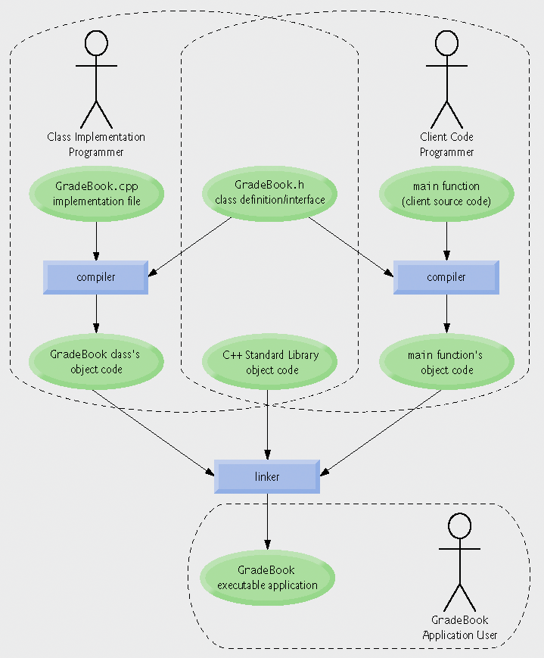
Fig.19.14 | Compilation and linking process that produces an executable application.

Slide 45
19.10 Validating Data with set Functions
set functions can validate data
  Known as validity checking
  Keeps object in a consistent state
    The data member contains a valid value
  Can return values indicating that attempts were made to assign invalid data
string member functions
  length returns the number of characters in the string
  Substr returns specified substring within the string

Slide 46
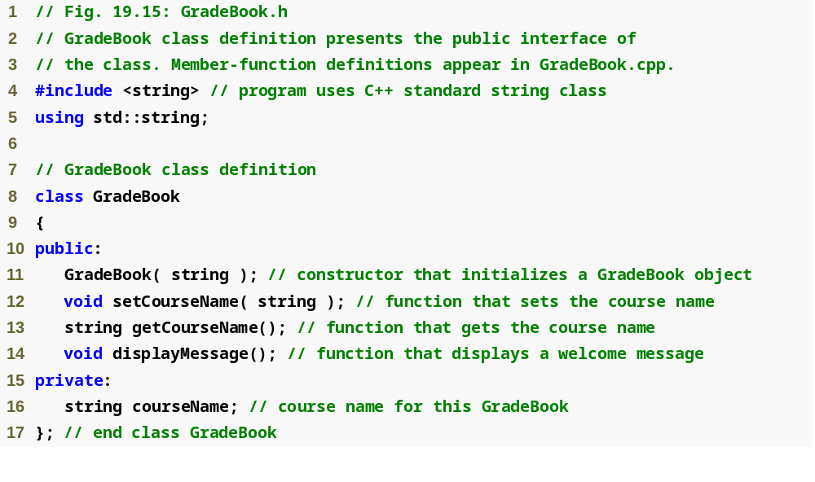
Outline
fig19_15.cpp
(1 of 1)

Slide 47
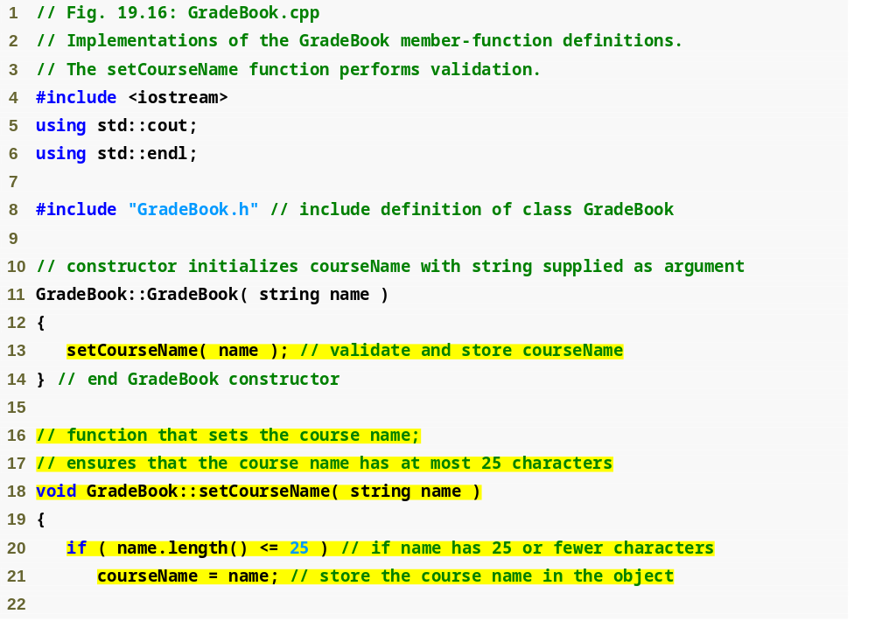
Outline
fig19_16.cpp
(1 of 2)
Constructor calls set function to perform validity checking
set functions perform validity checking to keep courseName in a consistent state

Slide 48
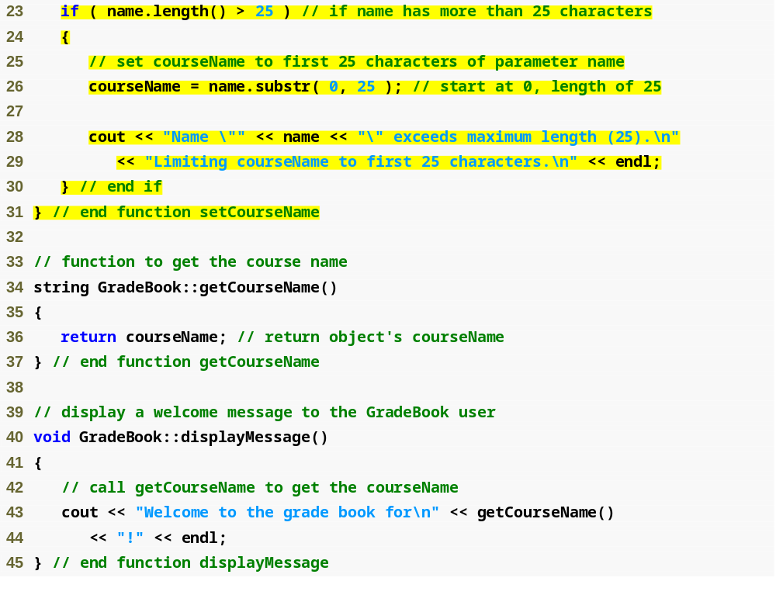
Outline
fig19_16.cpp
(2 of 2)

Slide 49
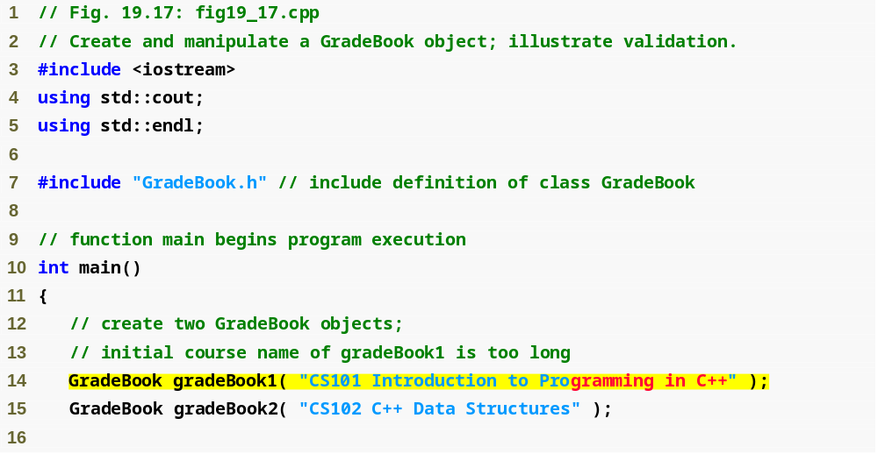
Outline
fig19_17.cpp
(1 of 2)
Constructor will call set function to perform validity checking

Slide 50
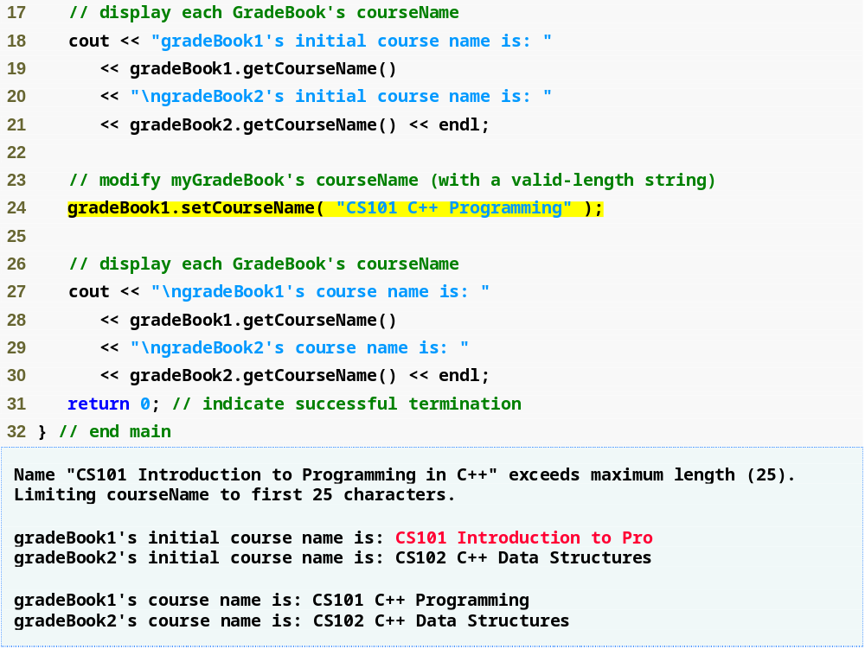
Outline
fig19_17.cpp
(2 of 2)
Call set function to perform validity checking

Slide 51
Software Engineering Observation 19.6
Making data members private and controlling access, especially write access, to those data members through public member functions helps ensure data integrity.

Slide 52
Error-Prevention Tip 19.5
The benefits of data integrity are not automatic simply because data members are made private—the programmer must provide appropriate validity checking and report the errors.

Slide 53
Software Engineering Observation 19.7
Member functions that set the values of private data should verify that the intended new values are proper; if they are not, the set functions should place the private data members into an appropriate state.

